Slide 1
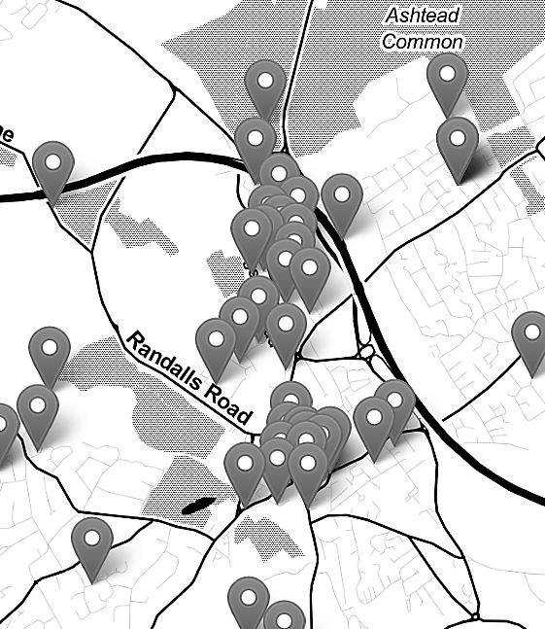

Mapping Crime Data in R: An Introduction to GIS and Spatial Data (06/03/2023)
Nadia Kennar, Research Associate at the UK Data Service (Cathie Marsh Institute, UoM)
Copyright © 2023 University of Manchester, Cathie Marsh Institute, UK Data Service.

Slide 2
Upcoming CSS Events:
Computational Social Science Drop-in - 14/03/2023
An Introduction to Time Series Analysis and Forecasting – 04/04/2023 + 06/04/2023
How to become a computational social scientist – 18/05/2024
For the full list of events browse our event page
https://ukdataservice.ac.uk/training-events/

Slide 3
Interaction
During this workshop you can use the Zoom chat for technical questions or comments (to chat with the facilitator – Emma Green).
If you want to ask questions in relation to the content of this talk, then you can use the Zoom Q+A function.
This Workshop will involve several polls, short answers and other interactions where all answers will appear anonymously on the screen. For this, you need to go to menti.com and enter the 8 digit code at the top of the screen .
Lets test this now!

Slide 4
Instructions

Slide 5
Can you hear me poll

Slide 6
Troubleshooting audio problems
Check your speaker/headset is plugged in / volume is on.
Click on audio to change to listening via phone
This workshop is live on YouTube. We are also recording this workshop and will post it on YouTube (https://www.youtube.com/user/UKDATASERVICE)

Slide 7
Workshop Content – March 6th 2023
What is GIS
Spatial Data vs Non-Spatial Data
Different types of maps (reference vs thematic)
Projection Methods and Coordinate Reference Systems
Challenges of Mapping Crime Data

Slide 8
Live Code Demo – March 9th 2023
Topic 1 – Exploring our crime data
Topic 2 – Shapefiles
Topic 3 – Combining census data (crime rate)
Extra Topic – Interactive maps via Leaflet Package

Slide 9
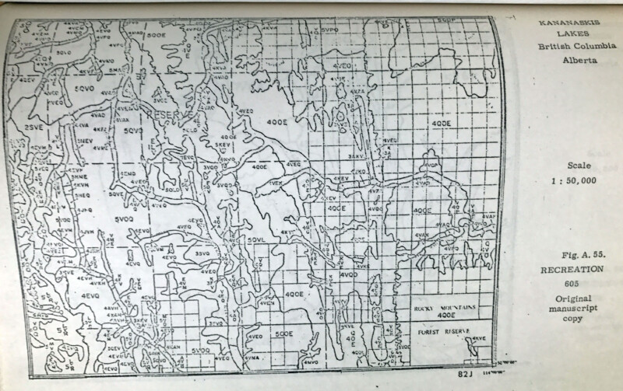
What is GIS?
Graphical Information Systems:
“computer system for capturing, storing, checking, and displaying data related to positions on Earth’s surface”

Slide 10
Continued.
All data in GIS is ‘georeferenced’ meaning it has both;
Attribute (what it is)
Location (where it is, a known location)

Slide 11

What software's are available?
GeoDa,
ArcGIS,
FME,
QGIS,
R
…

Slide 12
How is GIS used?
Identify problems
Monitor change
Manage and respond to events
Perform forecasting
Set priorities
Understand trends
Reference: https://www.esri.com/en-us/what-is-gis/overview#liSwitcher

Slide 13
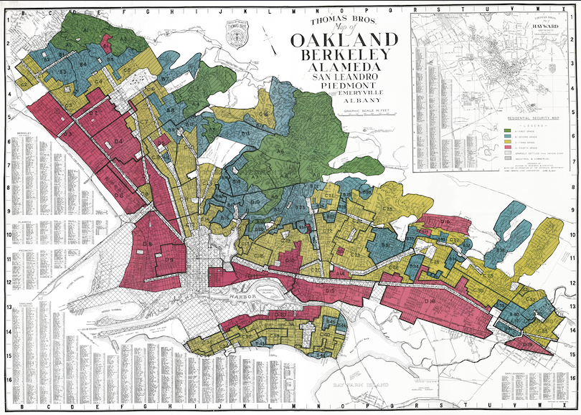
'Redlined Maps’
The history of ‘Redlined’ maps
The social effects
The physical environment

Slide 14
Here are just some of the questions that GIS allows us to explore with crime data.
Where are the most vulnerable communities located?
Why do crimes occur in one area and not the other
How do offenders travel to the crime location?
Where are there more or less stop and search than we would expect in relation to the distribution of crime?

Slide 15
Reference vs Thematic Maps
Reference Maps: used to communicate location on more static data points
To ‘pin point’ data on a map
Descriptive
Thematic Maps: used to highlight a spatial relationship
To ‘study a theme’ within a map
Explanatory

Slide 16
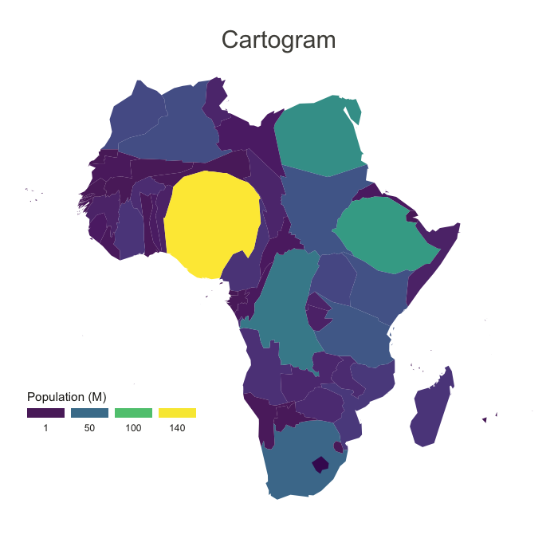
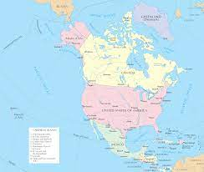
Reference vs Thematic Maps Continued…
Vs

Slide 17
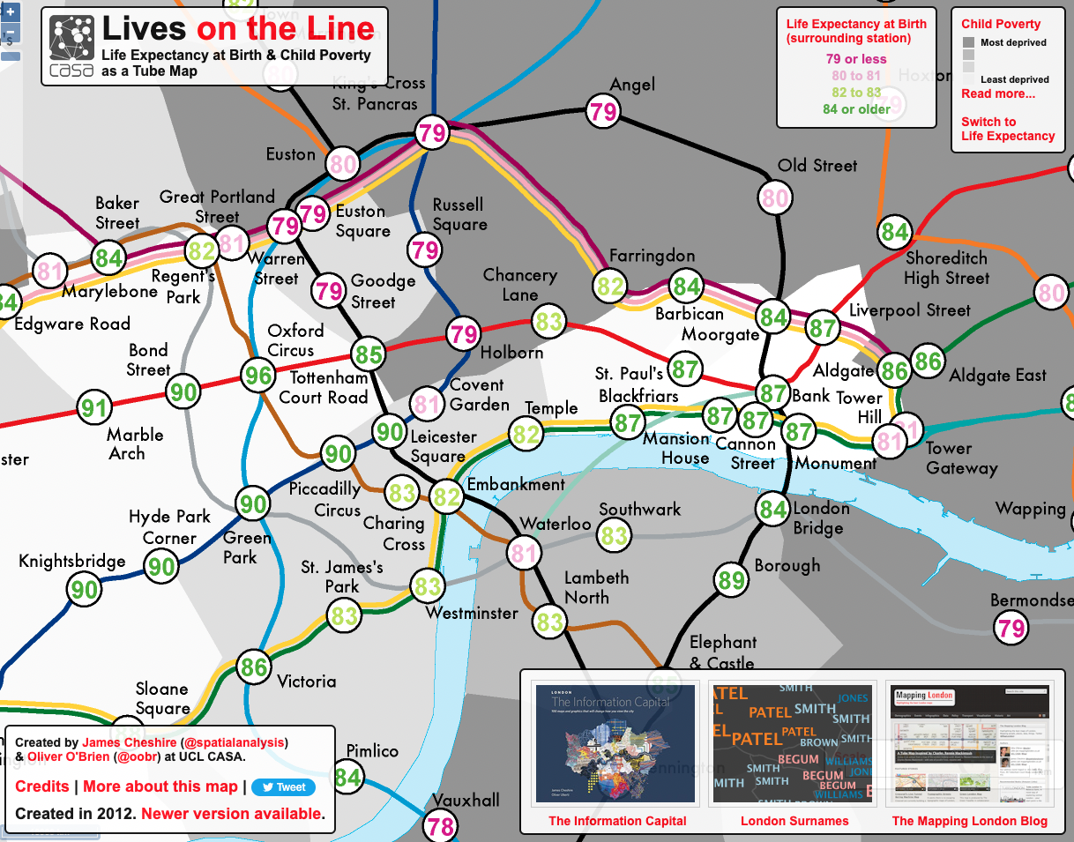
Tube Map Example (source = https://www.crimrxiv.com/pub/slkb1v54/release/1)

Slide 18
Tube Map Example
How do we class Tube Maps;
Reference maps because…
They show the location of different tube stations, and the location of each tube line
Thematic maps because...
They can be used to predict life expectancy, poverty and median house prices
Have a go exploring this!!
https://tubecreature.com/#/livesontheline/current/same/U/*/FFTFTF/11.469326848406268/-0.1622/51.5142/

Slide 19
Scenario 1: The visualisation of road networks to improve road safety measures are a type of

Slide 20
Scenario 2: The visualisation of the earths surface, showing its elevation, is a type of

Slide 21
Scenario 3: Navigation tools such as Google maps or City-Mapper can be classed as

Slide 24
To sum up
All though maps falls broadly into two categories, there are ways in which these types of map overlap or share similarities
Almost every thematic maps is also a reference map, but not every reference map is a thematic map
The decision is up to you, it is not entirely necessary to define these in your work but it is important to now what type of map you want to make as these can be affected by the data you have

Slide 25
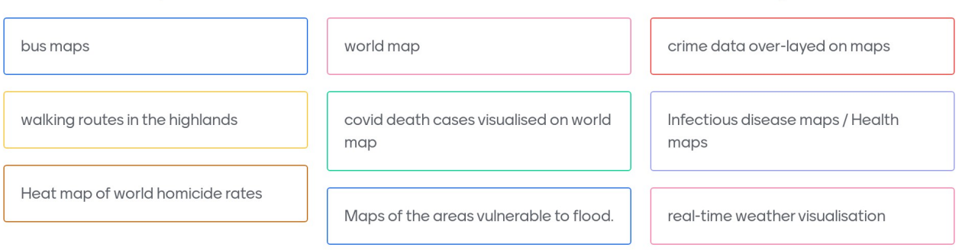
Can you give examples of any other types of map that share qualities of both thematic and reference maps?

Slide 26
What is Spatial Data?
Spatial data (or geospatial data) is a data frame that contains information about a specific location, which can be analysed to better understand that location.
GIS enables this spatial data to be processed and analysed.
Two types: Vector and Raster

Slide 27
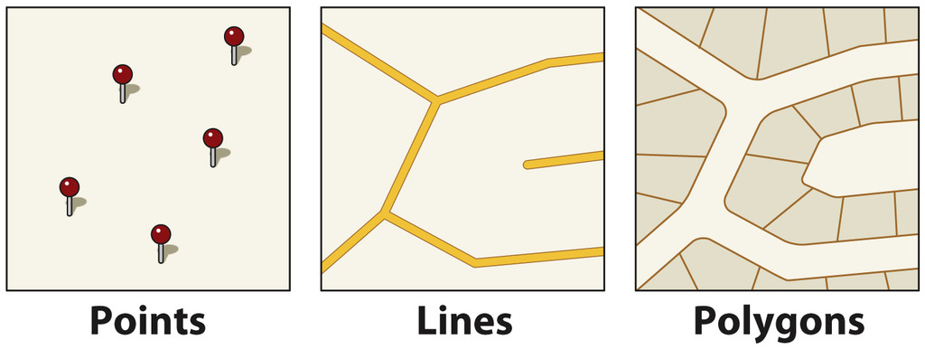
Vector Data
Vector Data (points, lines and polygons)

Slide 28
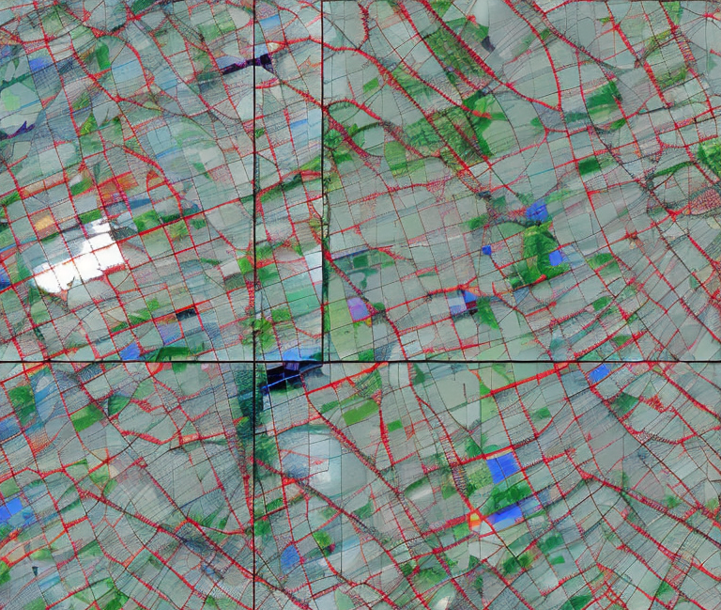
Raster Data
Imagery or satellite data that are formed from a grid of pixels.

Slide 30
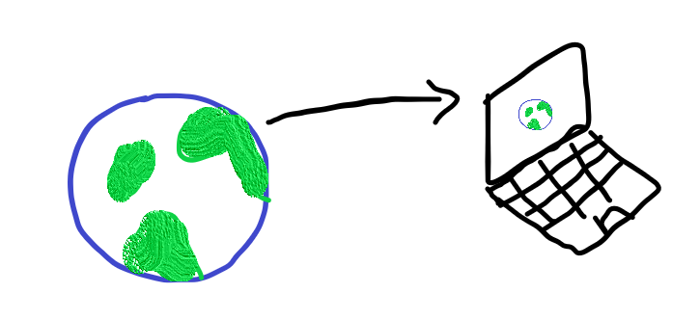
Projection Methods
Moving from the 3D to the 2D

Slide 31



Football Example

Slide 32
Distortion
The misrepresentation of…
-> Area
-> Shape
-> Distance
-> Direction of points

Slide 33
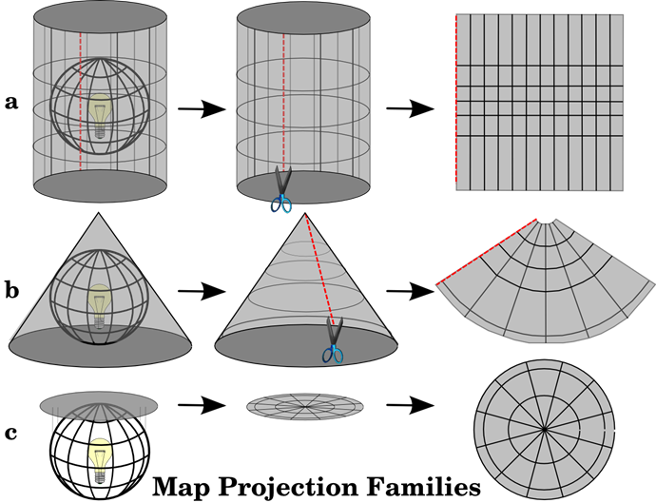
Distortion
Cylindrical
Conical
Planar

Slide 34
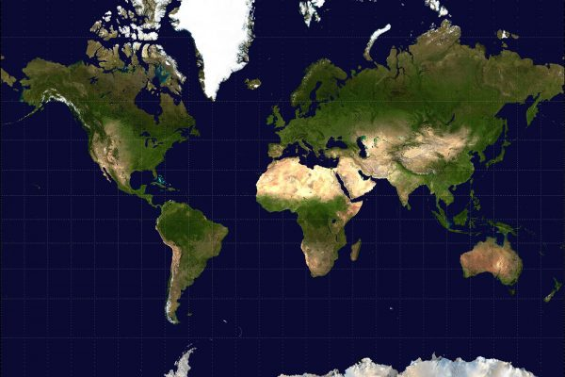
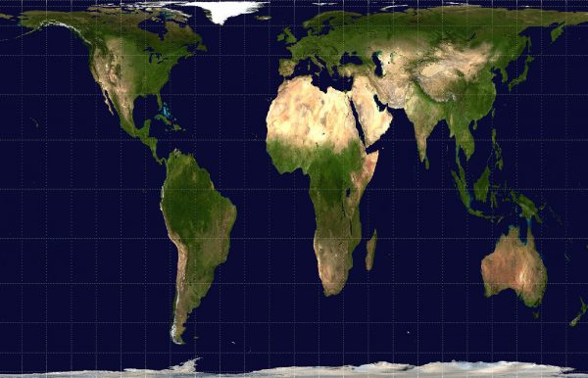
Web Mercator vs Gall-Peter Projection

Slide 35
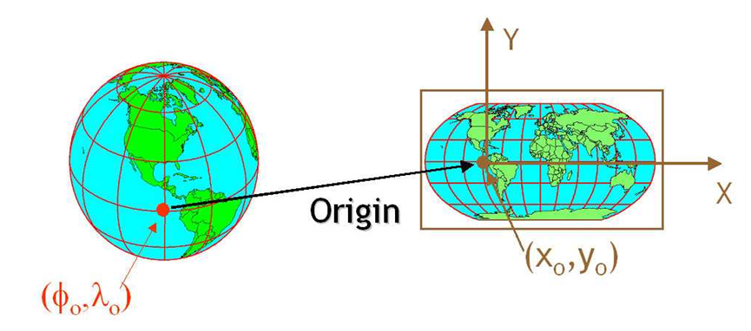

So, how do we actually move from the 3D to the 2D?

Slide 36
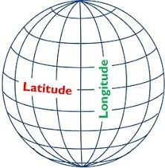
Coordinate Reference Systems (CRS)
The move from the 3D to the 2D is done with the help of CRS
Every place on earth is specified by three numbers (i.e. coordinates)
Latitude, longitude and Altitude
Notes:
A geographic coordinate system (GCS) is a reference framework that defines the locations of features on a model of the earth. It’s shaped like a globe—spherical. Its units are angular, usually degrees.
A projected coordinate system (PCS) is flat. It contains a GCS, but it converts that GCS into a flat surface, using math (the projection algorithm) and other parameters. Its units are linear, most commonly in meters.
https://www.esri.com/arcgis-blog/products/arcgis-pro/mapping/coordinate-systems-difference/#GCS

Slide 37
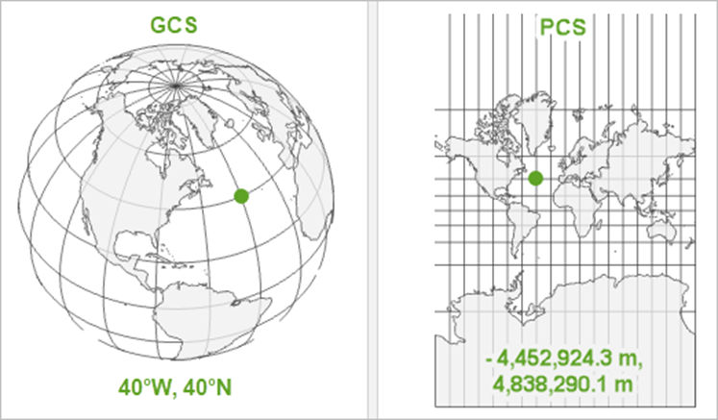
CRS continued…
There are two Main CRS:
Geographic Coordinate System vs Projected Coordinate Systems
The ‘where’
The ‘how’

Slide 38
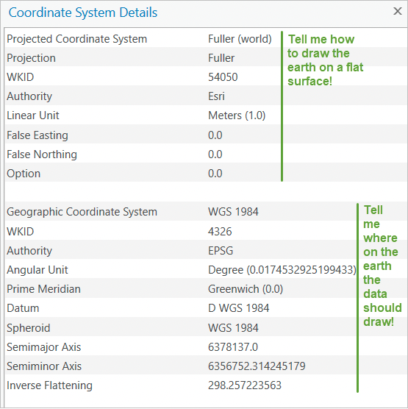
CRS example
Remember that a PCS, is just a GCS that has been projected !

Slide 39
Spatial Analysis
Buffering
Overlay Analysis
Interpolation
Kernel Density Estimation
Spatial Autocorrelation
Hot-spot / Hot-Routes

Slide 40
What are the main challenges of mapping crime data?
Geomasking and geoprivacy
The accuracy of police recorded statistics
The grey figure of crime
Conceptual issues surrounding its definitions of crime types
The impacts of seasonality; how has Covid-19 affected police recorded crime statistics
Can you think of anymore?

Slide 41
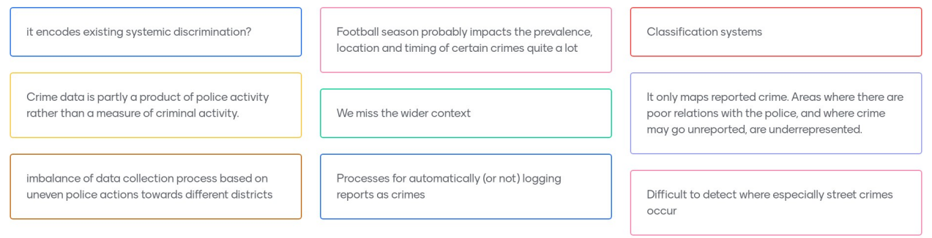
What are the main challenges of mapping crime data?

Slide 42
Material for the live code demonstration (08/03/2023)
GitHub:
https://github.com/UKDataServiceOpen/Crime_Data_in_R
(under the March_2023 folder)

Slide 43
Any Questions…

Slide 44
References
https://www.esri.com/en-us/what-is-gis/overview#liSwitcher
https://blog.ukdataservice.ac.uk/gis-spatial-data/
Dermanis (2005) : https://www.researchgate.net/profile/Athanasios-Dermanis/publication/233387161_Coordinates_and_Reference_Systems_in_Greek/links/0912f50a149d9568b7000000/Coordinates-and-Reference-Systems-in-Greek.pdf
Luc Anselin (2009) : https://link.springer.com/chapter/10.1007/978-3-642-03647-7_5
Ratcliffe (2009) Spatial and Temporal Challenges: https://link.springer.com/chapter/10.1007/978-0-387-77650-7_2
Bowers (2001) Mapping and Analysing Crime Data : https://link.springer.com/chapter/10.1007/978-0-387-77650-7_2
https://core.ac.uk/download/pdf/161890428.pdf
https://www.ed.ac.uk/files/imports/fileManager/chainey.pdf
https://www.crimrxiv.com/pub/slkb1v54/release/1
https://tubecreature.com/#/livesontheline/current/same/U/*/FFTFTF/11.469326848406268/-0.1622/51.5142/
https://www.crimrxiv.com/pub/slkb1v54/release/1

Slide 45
Survey
When you leave the webinar, please complete our short survey
Just click on ‘continue’ to access the survey.

Slide 46
Thank You.
Email: nadia.kennar@manchester.ac.uk
Twitter: @NadiaKennar

